Slide 1
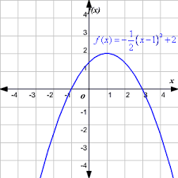
Bell Work: Identify the following: Max or Min Y-Intercept X-Intercept (root) Domain Range End Behavior

Slide 2
ALGEBRA 3
Day 15

Slide 3
Chapter 2 Section 1 Relations and Functions
Objective: To be able to identify, and compare/contrast relations and functions
Introduce Domain and Range

Slide 4
Relation vs Function
Relation: a mapping, or pairing, of input values with output values
Function: if there is exactly one output for each input
(One y for each x… Not a function if one x has more than one y)
Example: Is the following a relation or function? Why?
1.) (3, 4) (5, 0), (-1,4) 2.) (1,3) (-2, 12) (1, 2)

Slide 5
Another way to ask the same thing…
X
Y
X
Y

Slide 6
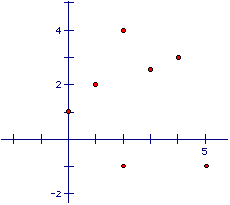
Another great way to determine if a relationship is a function is to graph (or at least visualize a graph) it
Vertical Line Test: A relation is a function if and only if no vertical line intersects the graph of the relation at more than one point
Example: Is it a function?

Slide 7
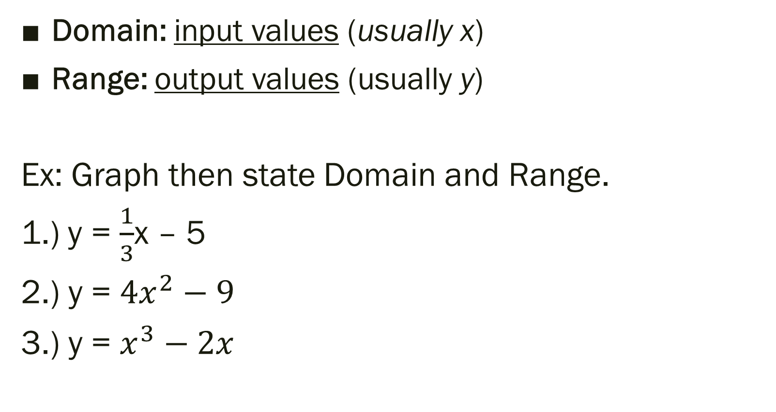
Intro to Domain and Range
Domain: input values (usually x)
Range: output values (usually y)
Ex: Graph then state Domain and Range.
1.) y = $\frac{1}{3}$x – 5
2.) y = ${4x}^{2}−9$
3.) y = $x^{3}−2x$

Slide 8

Have you seen or heard of function notation? Let’s chat…
For example:
$$f\left(x\right)=5x−8$$
or
$g\left(x\right)=x^{2}+x+6$

Slide 9
For Next Time…
New Material
Page 64 #1-5, 11-15, 17-19, 35
Mixed Review
Page

